Slide 1

Magnetic diffraction: Exploring hidden magnetic symmetries
Johan Cedervall
johan.cedervall@mmk.su.se

Slide 2
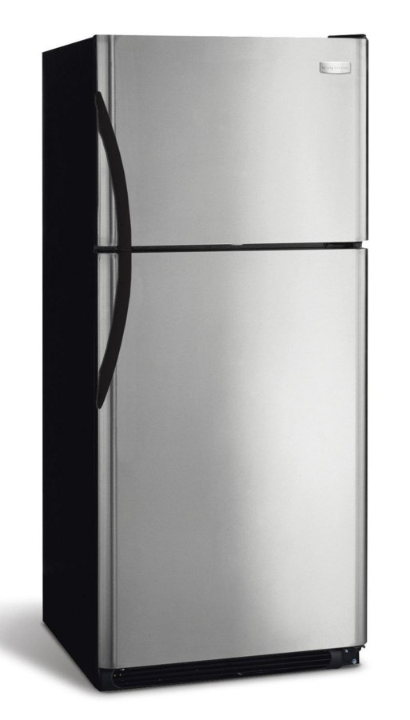
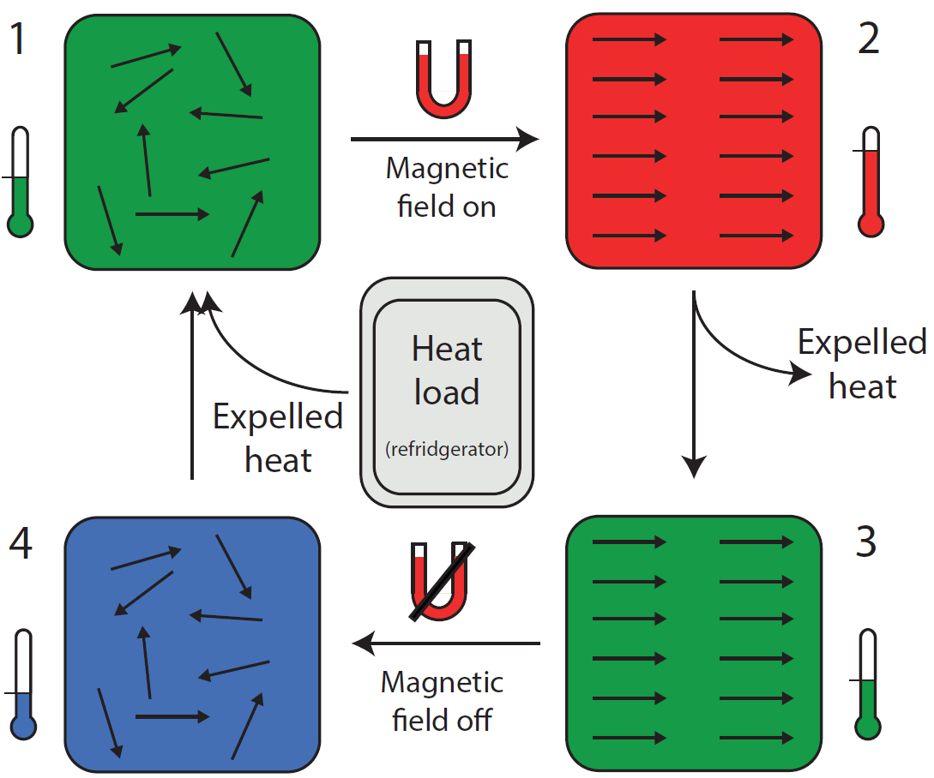
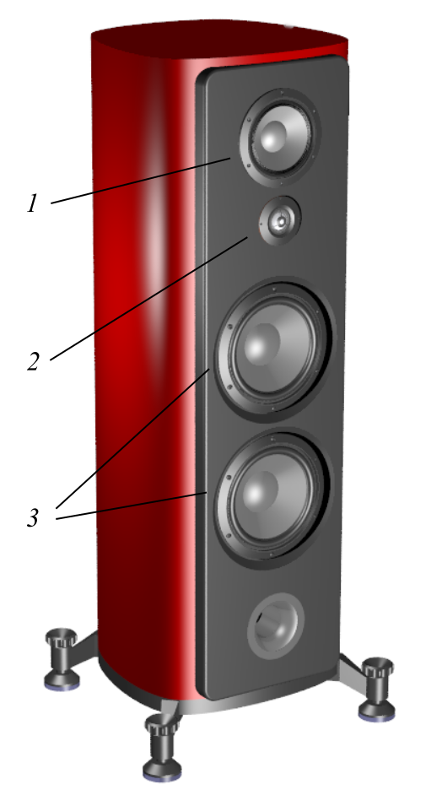
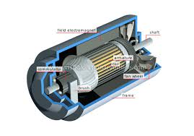


Magnetic materials

Slide 3
Neutron diffraction
X-rays
Small samples
Strong absorption
High energy (1 Å = 12.4 keV)
Low penetration depth
Light elements hard to detect
Scattering power highly Q dependent
Neighbouring elements cannot be discriminated
High availability (lab)
Cannot distinguish isotopes
Magnetic structures not easily probed
Neutrons
Large samples
Low absorption
Low energy (1 Å = 81.81 meV)
High penetration depth
Light elements can be seen
Scattering power almost Q independent
Neighbouring elements can be discriminated
Low availability (large scale fac)
Isotopes can be distinguished
Magnetic structures easily probed

Slide 4
Magnetic diffraction
MnO₂
I_{tot} = I_{nuclear} + I_{magnetic}
For ferromagnetic structures the magnetic unit cell equals the nuclear unit cell and there are extra magnetic contributions to the intensities of the reflections
For antiferromagnetic structures the magnetic unit cell is often larger than the nuclear one and there are extra pure magnetic reflections

Slide 5
Magnetic diffraction
Magnetic space groups
Similar to conventional space groups
Adds a parameter to relay the magnetic moment behavior
Compare
Pnma
Pn’m’a
1651 different magnetic space groups
Irreproducible representations
Symmetries are divided into the smallest possible representation (Γ)
Analysis is performed and only symmetry representations that are relevant are considered
Can build up complex models without space group restrictions

Slide 6
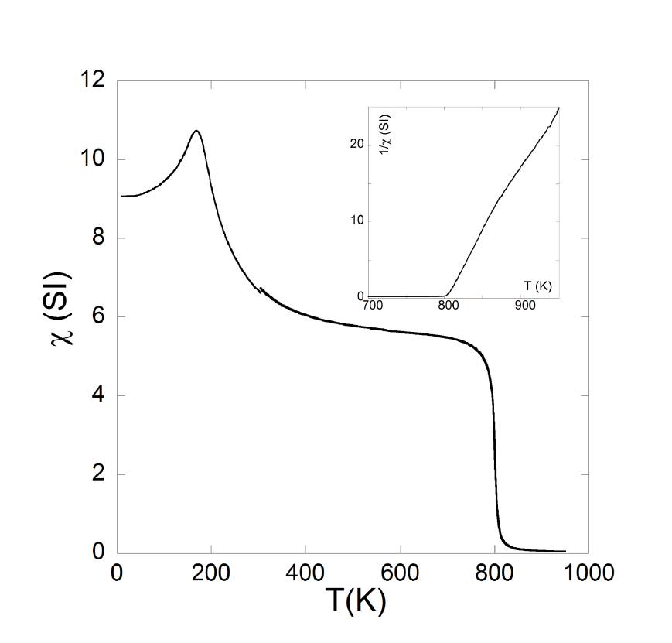
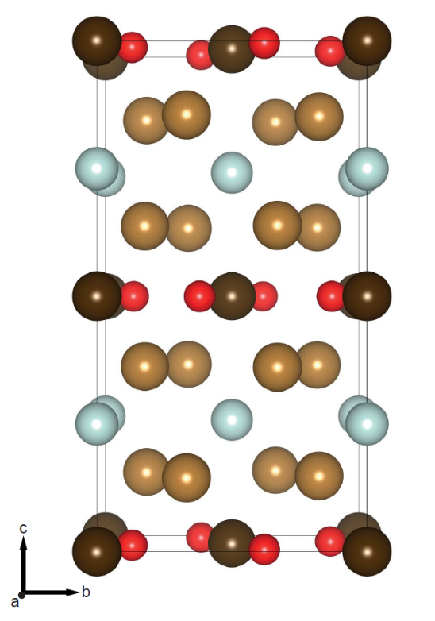
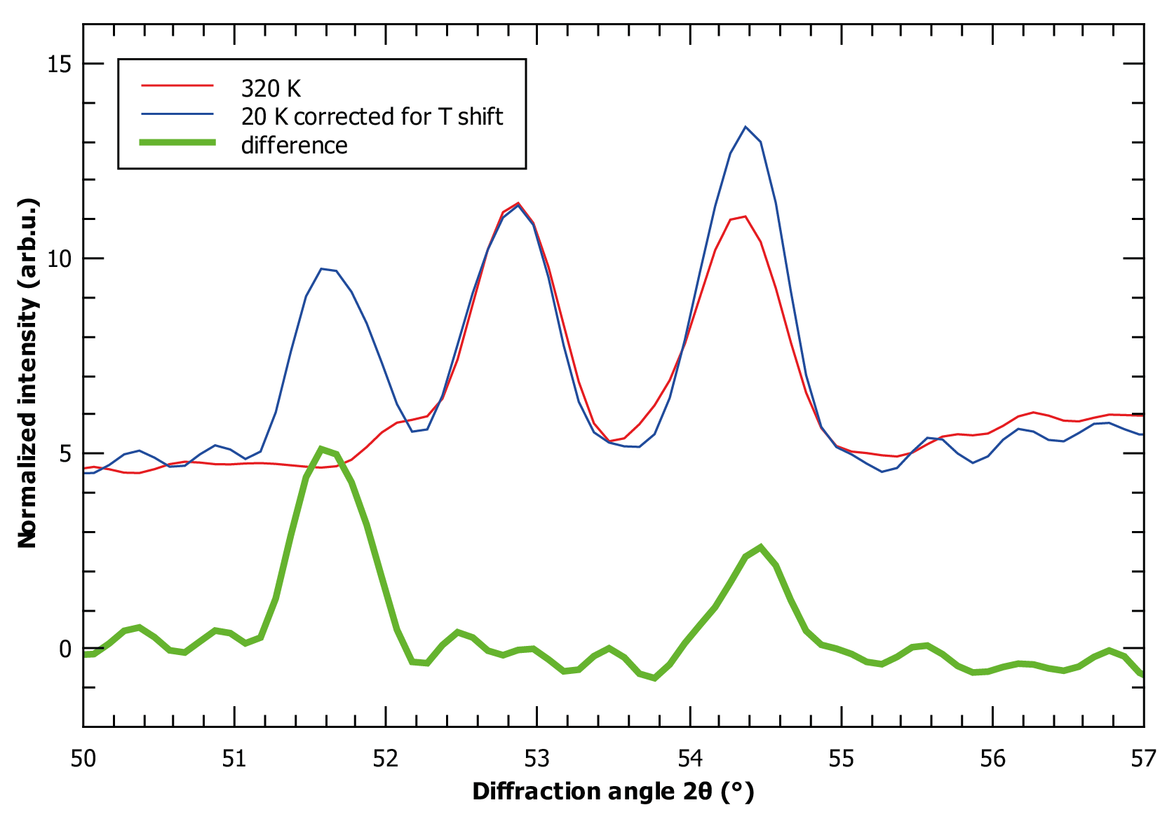
Magnetic diffraction
For all magnetic structure solution attempts other input parameters are needed:
Magnetic measurements
Crystallographic information
k-vector

Slide 7
Science examples

Slide 8
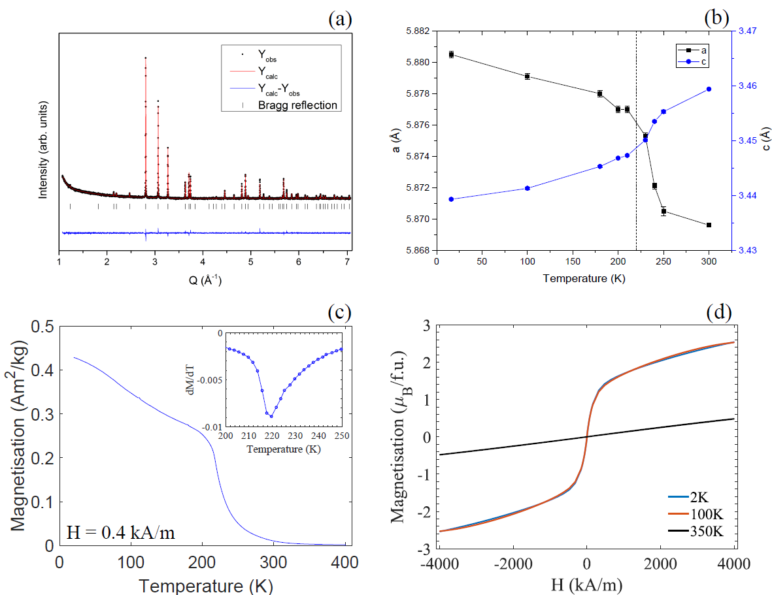
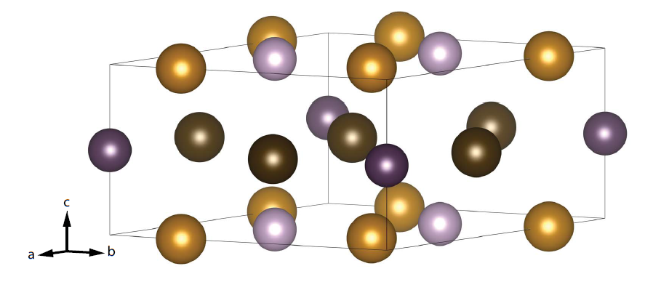
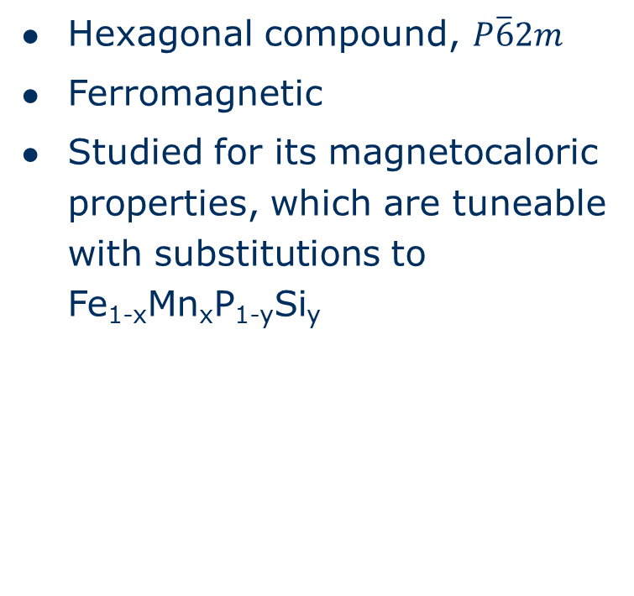
Fe₂P
Hexagonal compound, $P\overline{6}2m$
Ferromagnetic
Studied for its magnetocaloric properties, which are tuneable with substitutions to Fe_{1-x}Mn_{x}P_{1-y}Si_{y}
T_{C} = 220 K

Slide 9
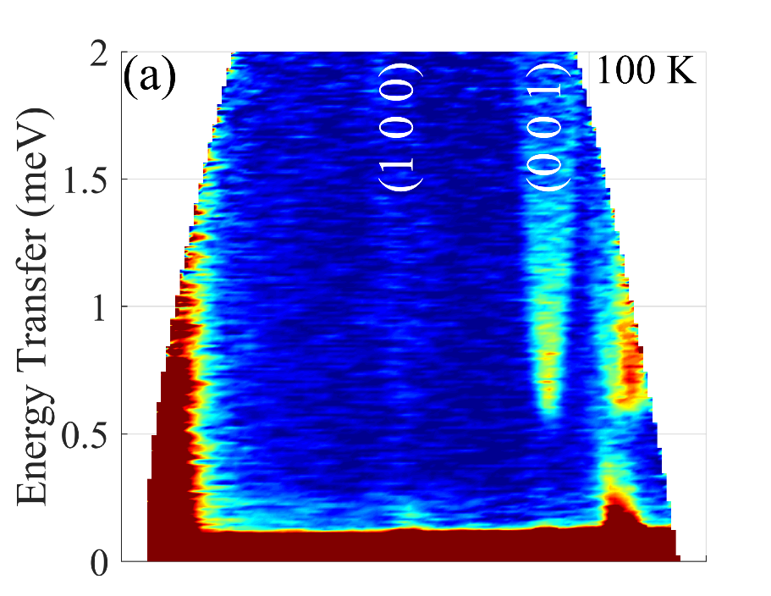
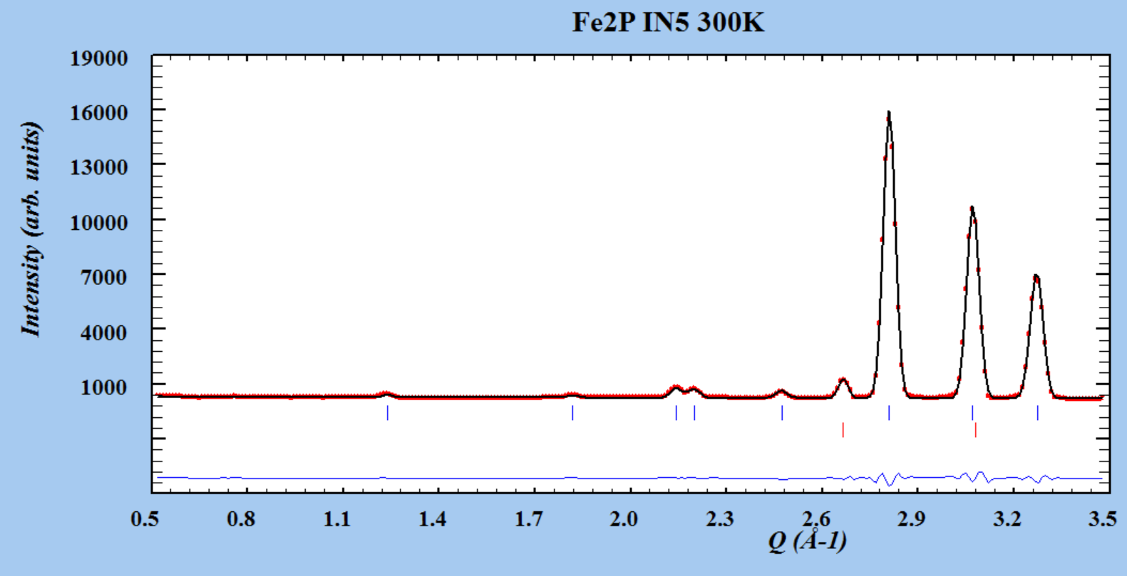
Fe₂P
Measurements conducted at IN5@ILL
J. Cedervall et al. Physical Review B 99 (2019) 174437

Slide 10
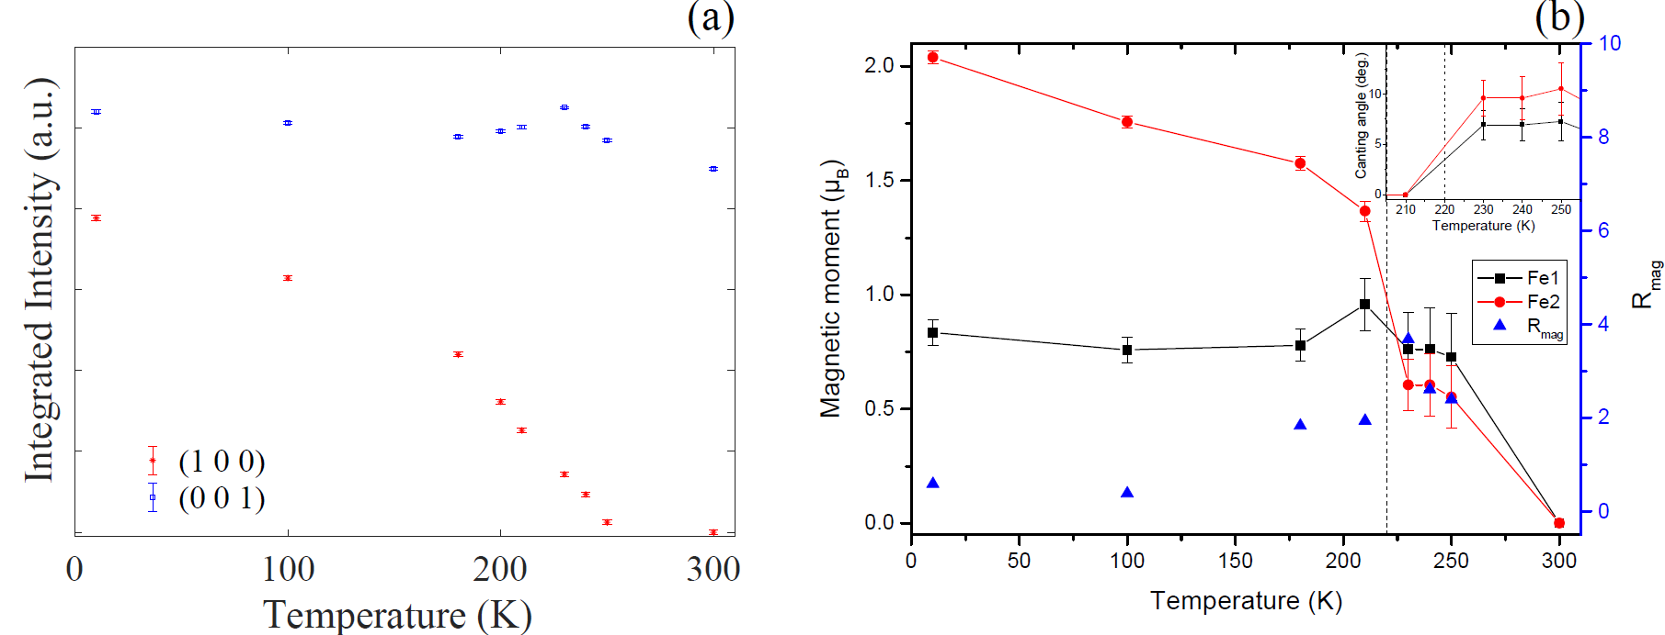
Fe₂P
Integrated intensity of (1 0 0) and (0 0 1) suggests a canting of the magnetic moments above(!) T_{C}
Also shown from magnetic structure refinements
Supported from Mössbauer spectroscopy
J. Cedervall et al. Physical Review B 99 (2019) 174437

Slide 11
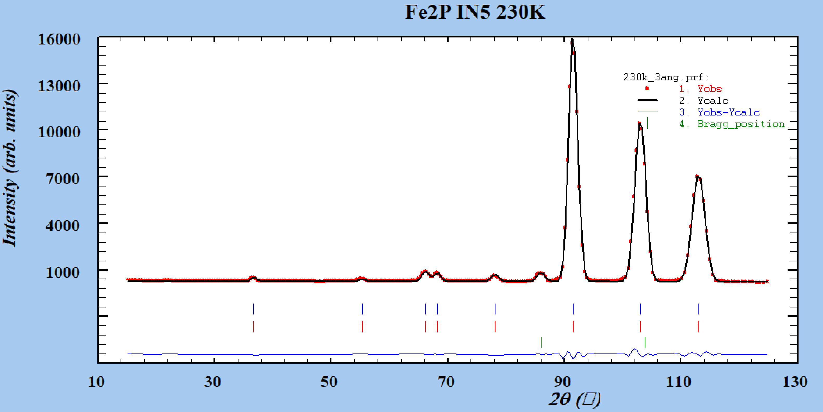
Fe₂P – magnetic structure solution
k-vector = (000) and ferromagnetic
Combining two irreproducible representations gives a solution for the magnetic moment in the ac-plane
J. Cedervall et al. Physical Review B 99 (2019) 174437

Slide 12

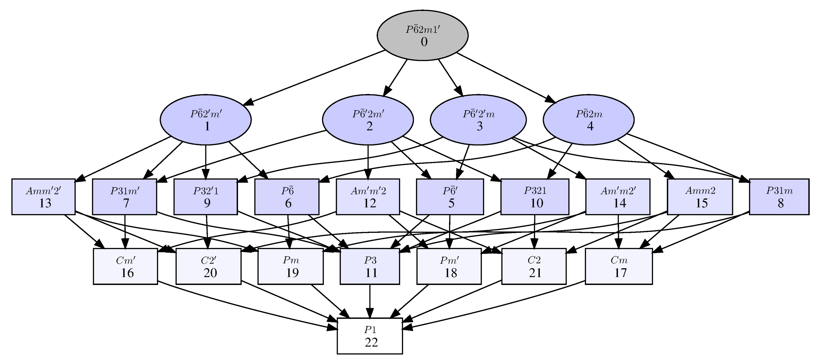
Fe₂P – magnetic structure solution
New measurements were performed using the beamline Polaris@ISIS with ambition of analyzing the magnetic short range order using mPDF
Magnetic models from IN5 could not be reproduced
Magnetic space groups were analyzed instead
Supports only directions along c, or ab

Slide 13
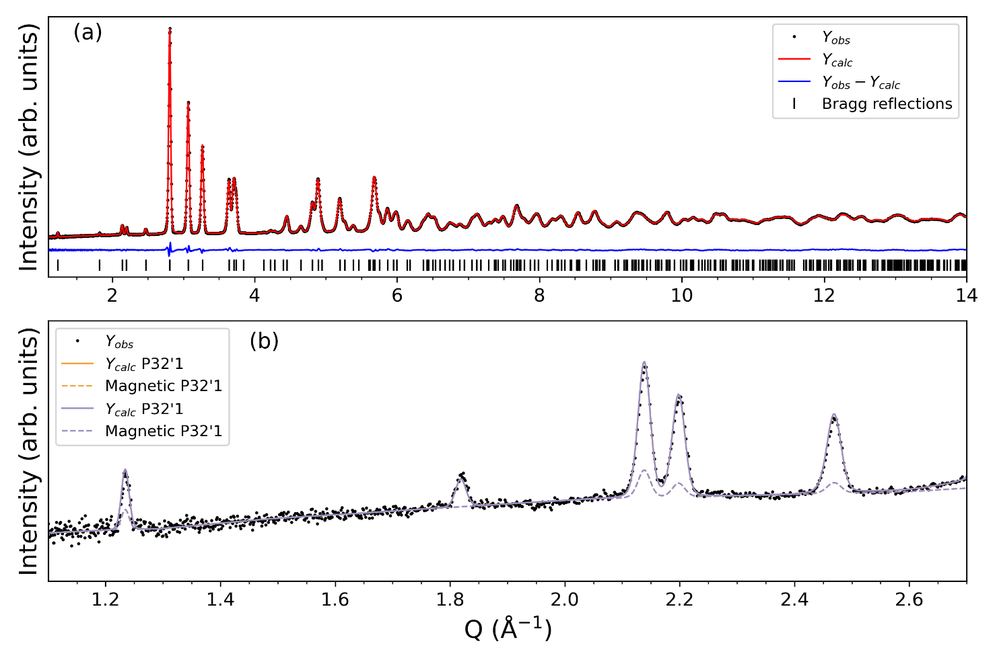
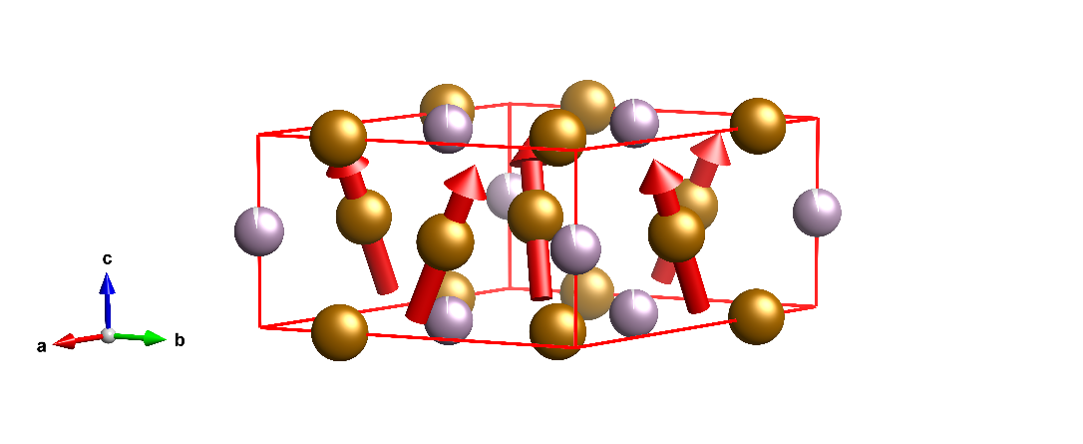
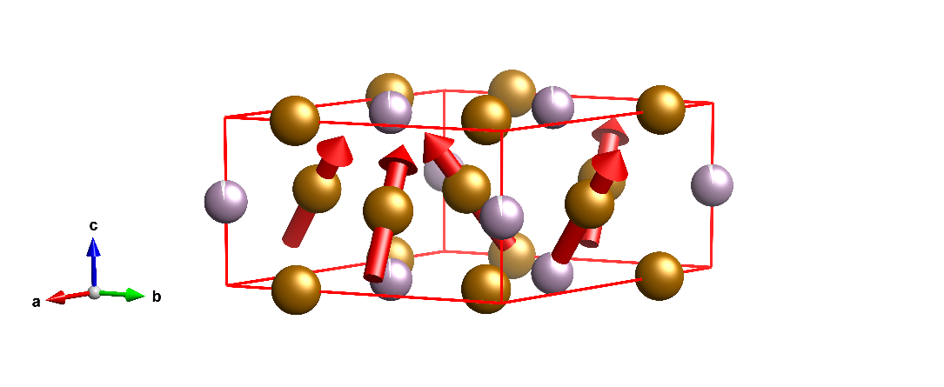



Fe₂P – magnetic structure solution
The space groups $P31m′$ and $P{32}^{′}1$ were both tested
Similar, indistinguishable magnetic structure solutions
$$P31m′$$
$$P{32}^{′}1$$

Slide 14
Fe₂P - summary
Canting close to T_{C} is observed using both irreps. and magnetic space groups
Magnetic moments are comparable to magnetometry results independent of magnetic structure model
Magnetic space group models suggest that one of the iron sites in the structure loses its magnetic moment before the other
Has been previously suggested by DFT calculations E. K. Delczeg-Czirjak et al. Physical Review B 82 (2010) 085103
To fully resolve the magnetic structure, single crystal neutron diffraction must be employed
Requires big(!) samples

Slide 15
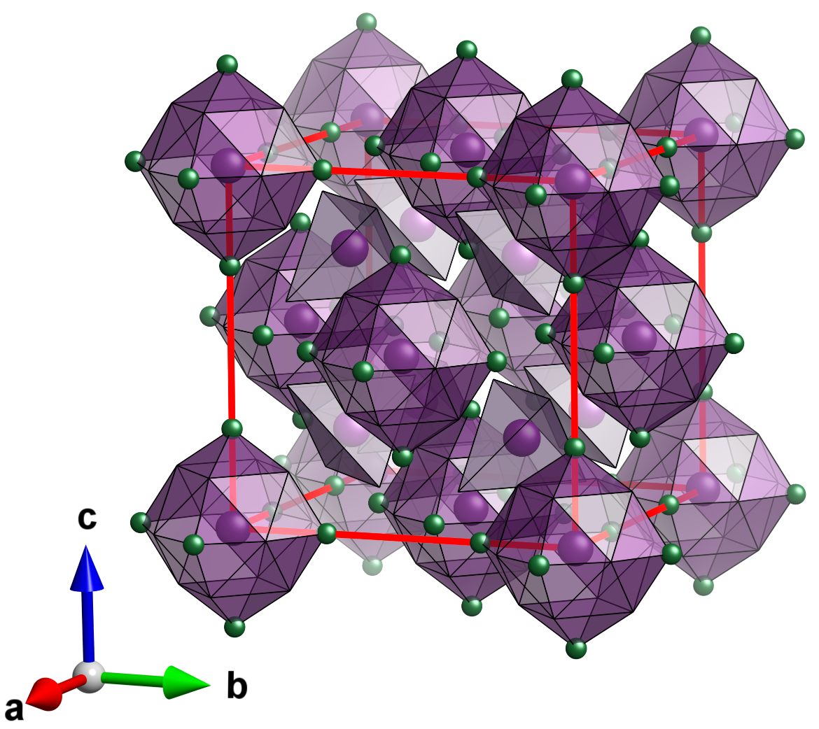
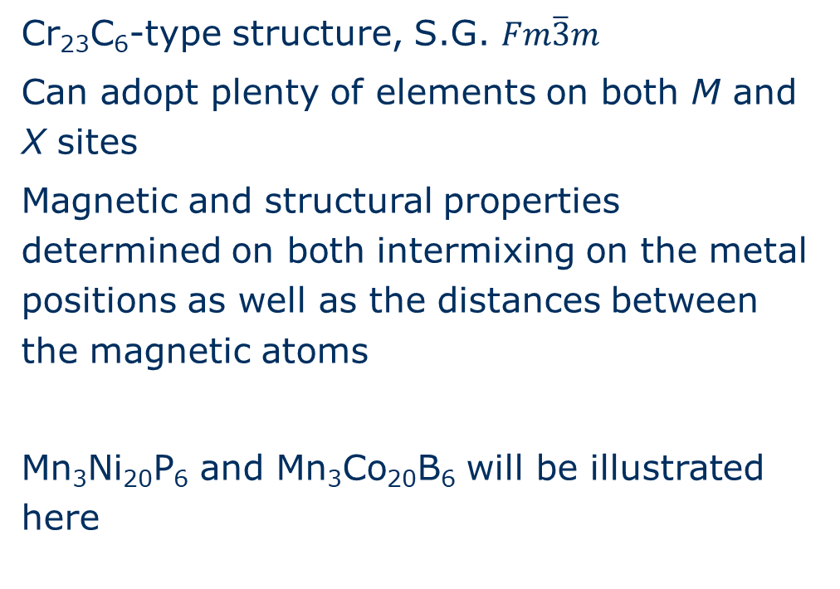
Mn₃M₂₀X₆
Cr₂₃C₆-type structure, S.G. $Fm\overline{3}m$
Can adopt plenty of elements on both M and X sites
Magnetic and structural properties determined on both intermixing on the metal positions as well as the distances between the magnetic atoms
Mn₃Ni₂₀P₆ and Mn₃Co₂₀B₆ will be illustrated here

Slide 16
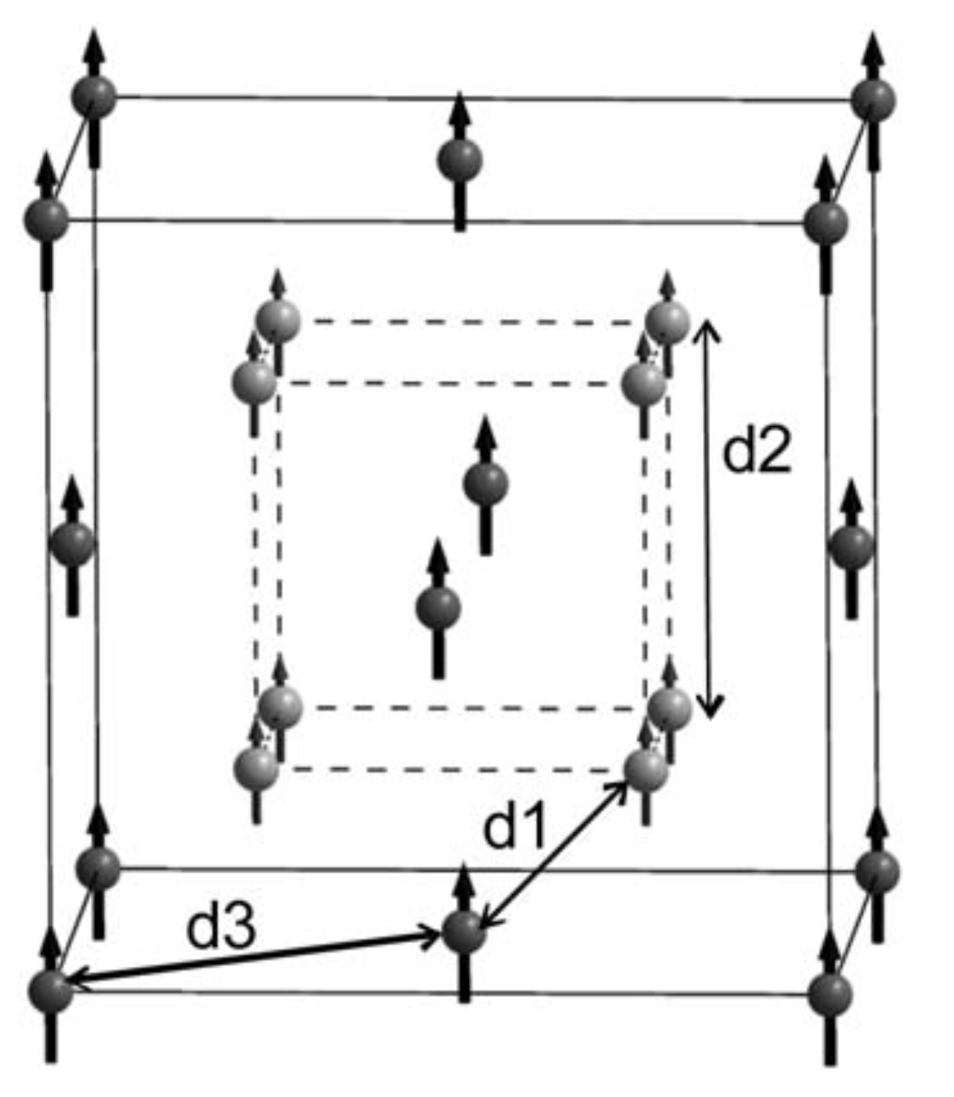
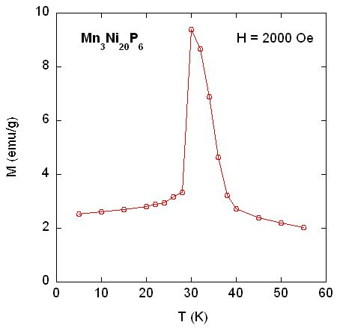
Mn₃Ni₂₀P₆
Mn₃Pd₂₀P₆ is ferromagnetic
T. Eriksson, et al. Journal of Magnetism and Magnetic Materials 308 (2007) 203-209
Substitutions of Pd to Ni gives a more complex magnetization curve
Only difference is the Mn-Mn distance

Slide 17
Complex magnetism in Mn₃Ni₂₀P₆
3 magnetic transitions
= 3 magnetic structures
at 30, 26 and below 20 K
J. Cedervall et al. Journal of Solid State Chemistry 237 (2016) 343–348

Slide 18
Complex magnetism in Mn₃Ni₂₀P₆
30 K
26 K
J. Cedervall et al. Journal of Solid State Chemistry 237 (2016) 343–348

Slide 19
Complex magnetism in Mn₃Ni₂₀P₆
30 K
26 K
<20 K
J. Cedervall et al. Journal of Solid State Chemistry 237 (2016) 343–348

Slide 20
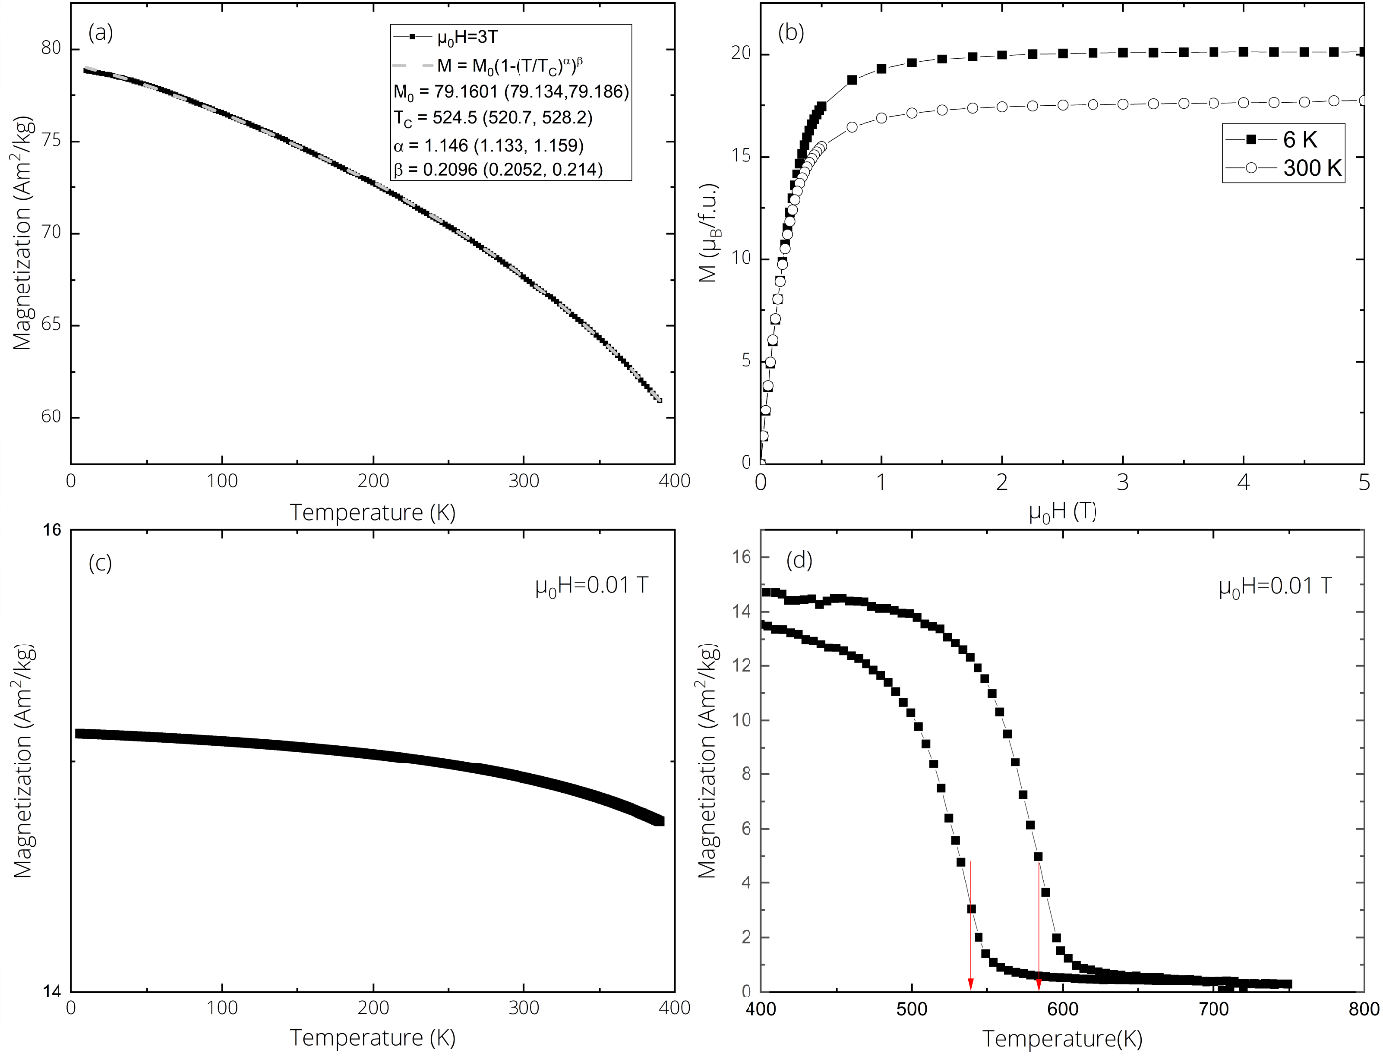

Ferromagnetism in Mn₃Co₂₀B₆?
Possibly stronger magnetic interactions compared to Mn₃Ni₂₀P₆ given the stronger magnetic element Co
Magnetomtry suggests a ferromagnetic ground state stable from T_{C} at 540 K down to 4 K
S.R. Larsen et al. Unpublished

Slide 21
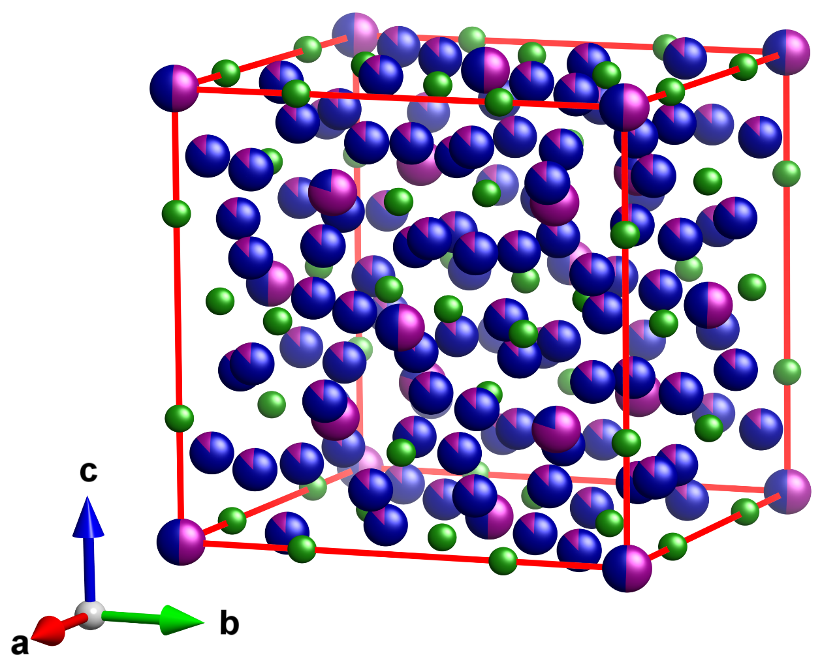
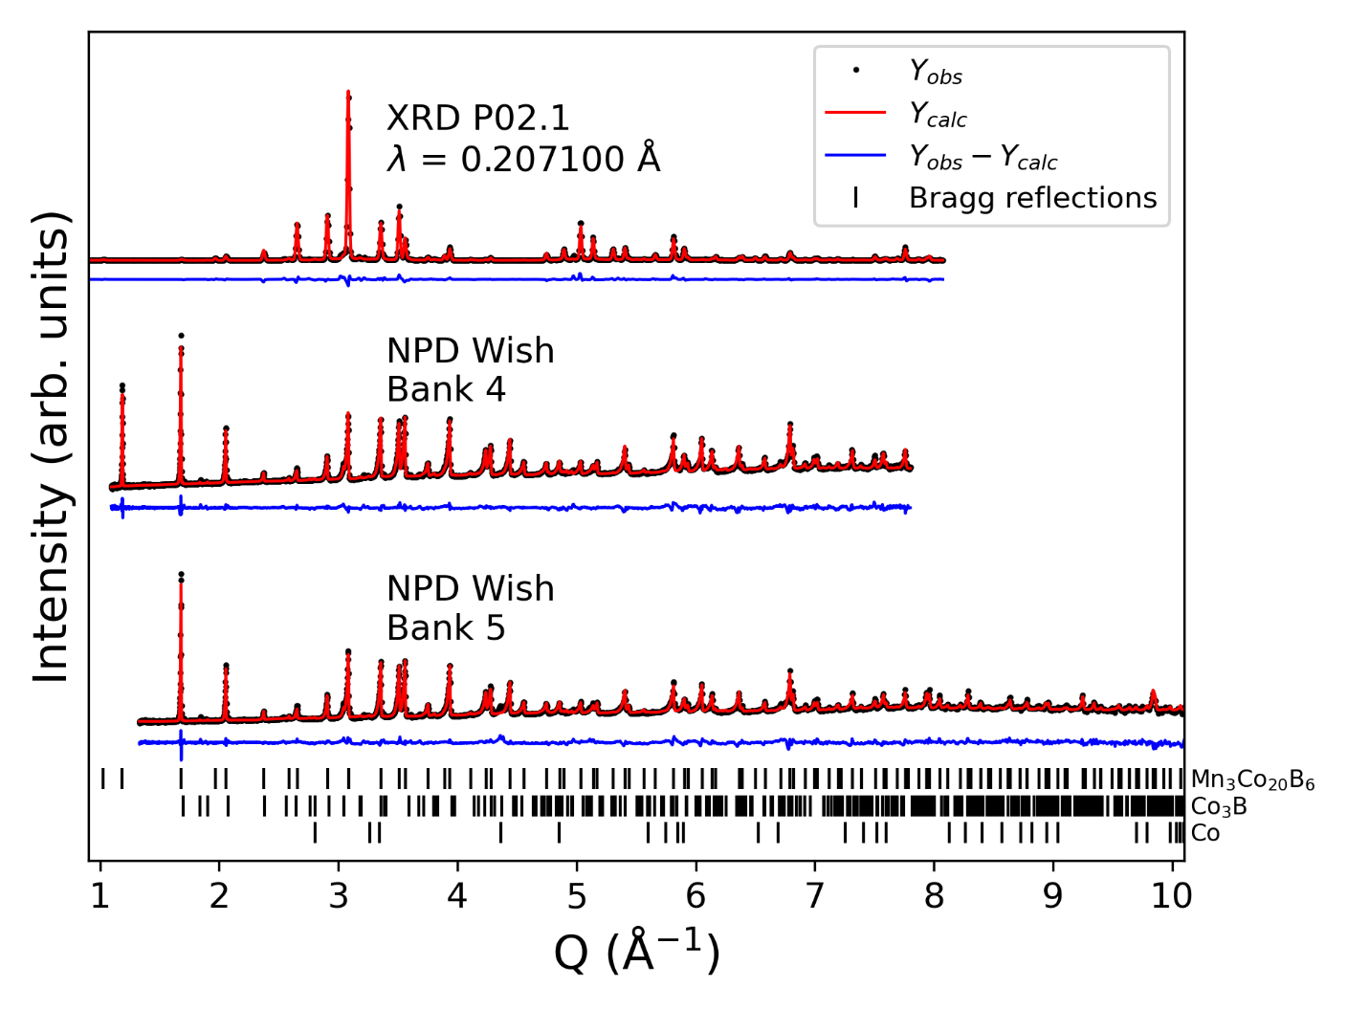
Ferromagnetism in Mn₃Co₂₀B₆?
Crystallographic information?
700 K
Mixed metal occupancies!
S.R. Larsen et al. Unpublished

Slide 22
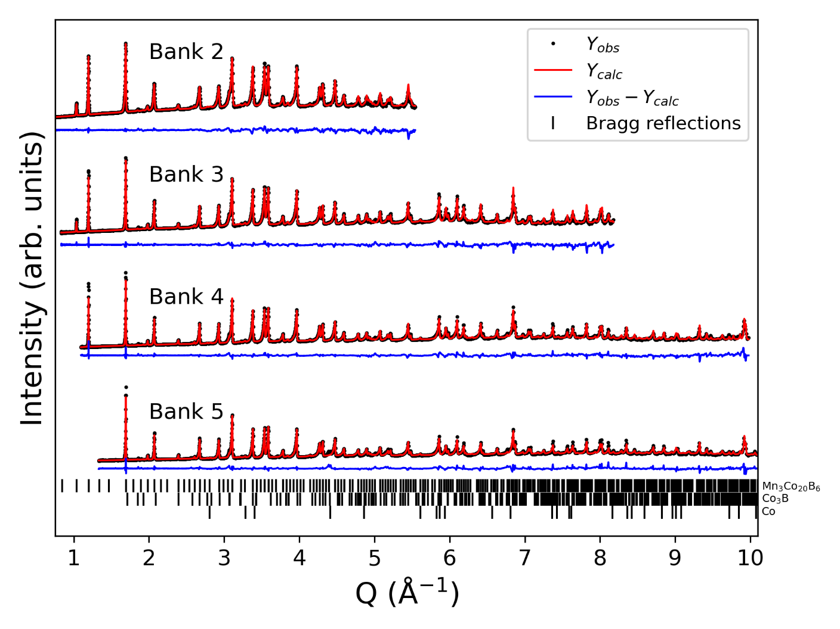
Ferromagnetism in Mn₃Co₂₀B₆?
k-vector = (0 0 0)
6 K
S.R. Larsen et al. Unpublished

Slide 23
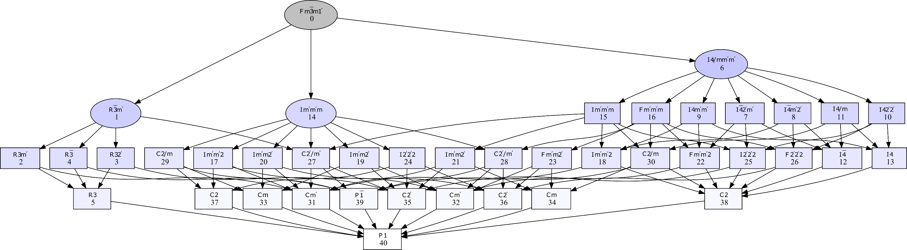
Ferromagnetism in Mn₃Co₂₀B₆?
Magnetic space groups
S.R. Larsen et al. Unpublished

Slide 24
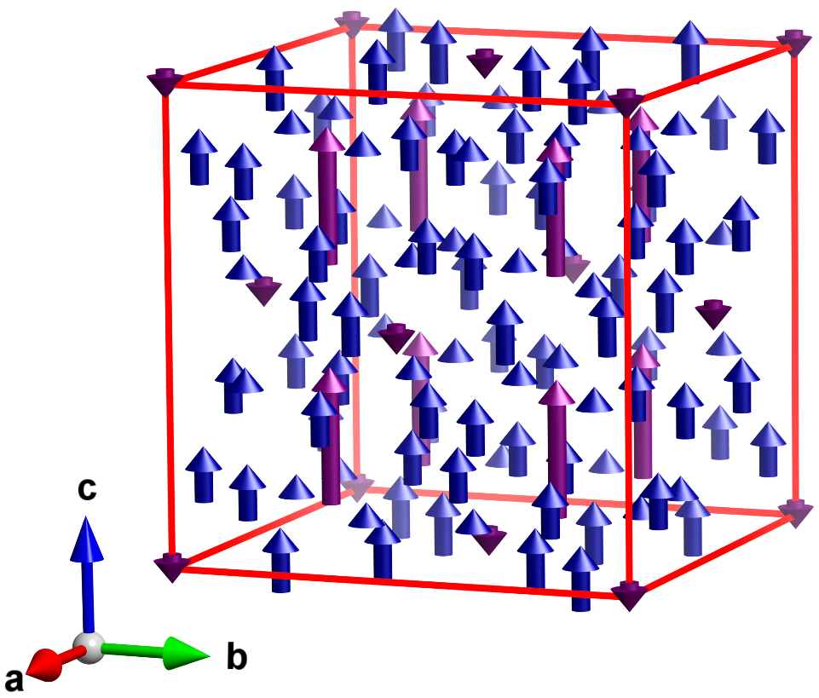
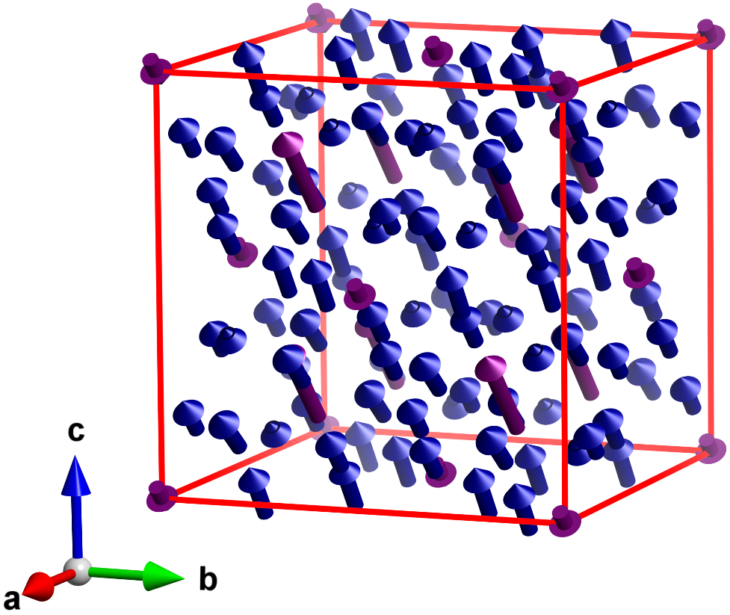
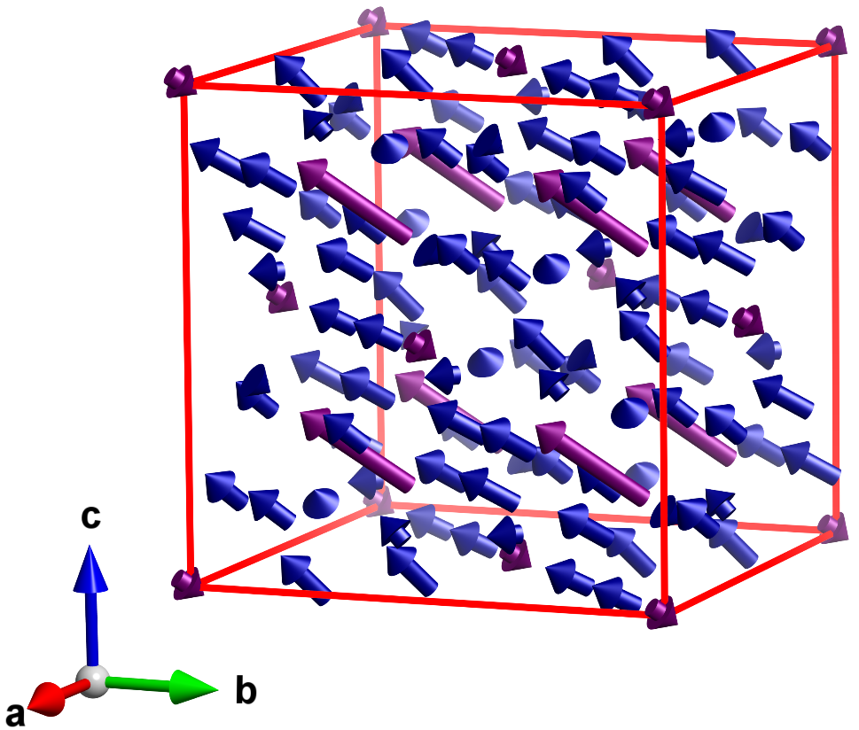



Ferromagnetism in Mn₃Co₂₀B₆?
3 different magnetic structure models describe the data equally well
$$I4/mm′m^{′}$$
$$Im^{′}m^{′}m$$
$$R\overline{3}m′$$
Ferrimagnetic!
Single crystals would solve the problem
S.R. Larsen et al. Unpublished

Slide 25

Mn₃M₂₀X₆ - summary
Atomic distances and intermixing of occupancies strongly interacts with the magnetic properties
Type of atoms important
Hard to distinguish similar structures using powder diffraction data

Slide 26
Summary
Magnetic structures are not easy to determine
Three essential input parameters when solving magnetic structures
Magnetic measurements
Crystallographic information
k-vector
Irreps or MSGs?
Two ways of describing the same thing
Complementarity between them
Detrimental for a complete understanding of the physics in the studied material
Magnetic structures are just the beginning!

Slide 27




Acknowledgements

