Slide 1
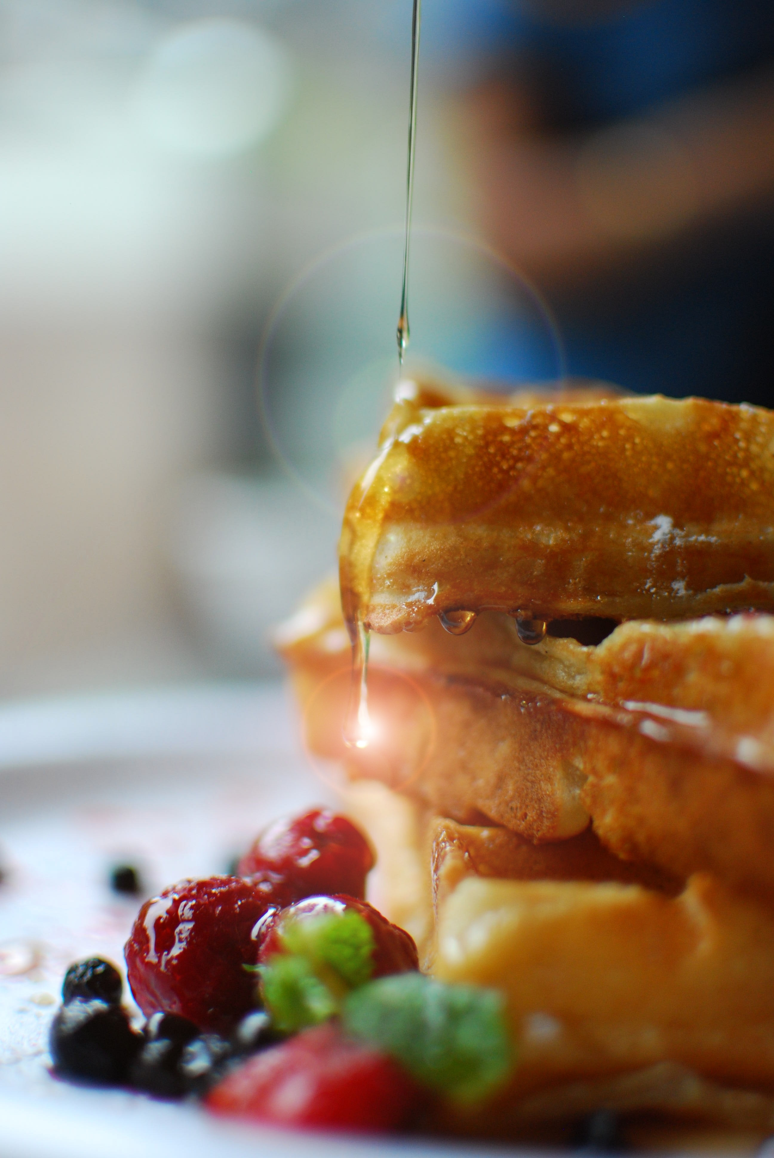
Masterclass Schedule
Monday August 29
12:00 Lunch and registration
12:45 – 13:15 Welcome, introduction of participants, practical information – Tommy Nylander, Milena Corredig, Emma Nordell
13:15 – 14:00 Food science research using spallation source neutrons and synchrotron source X-rays – Gregory Smith, ISIS, UK (ON LINE)
14:00-14:30 Food research examples – Bjorn Bergenstahl, Lund U
14:30 – 15:00 Break
15:00 – 16:00 Introduction to tomorrow's scattering workshop – Jacob Kirkensgaard, KU
16:00 – 17:00 Participants share research interests and context for masterclass – ALL
Notes:
Short introduction of the students

Slide 2
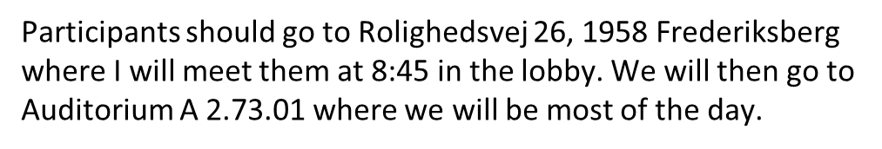
Masterclass Schedule
Tuesday August 30th in Copenhagen!
9 - 10 Introduction to SAXS modeling and hands on sessions
10 - 12 Groups 1 + 2 SAXS measurements / groups 3 + 4 Simulation and analysis
12 - 13 Lunch
13 - 15 Groups 3 + 4 SAXS measurements / groups 1 + 2 Simulation and analysis
15 - 17 Data analysis in Sasview of real data
Return to Lund....

Slide 3
Masterclass Schedule
Wednesday August 31st @Linx
09:00 – 9:45 Introductionto scattering–Ann Terry (MAX IV)
9:45- 10:30 Soft X ray imaging Jörg Schwenke (MAX IV)
10:30-11 Break and discussion
11:00- 12:00 A soft matter approach to protein structure studies Felix Roosen Runge Malmo U
12:00-12:45 lunch break and discussion
12:45- 13:30 SAXS on soft matter during digestion – Ben Boyd (KU)
13:30 – 14:15 Food structure, functionality and complementary techniques to s
synchrotron and X-rays - Niklas Loren, RISE
14:15- 15:00 An industry prospective . Finn Madsen (emeritus - IFF).
15:00- 15:30 Break
15:30- 16:15 Workshop - Writing a winning beam time proposal - Tommy Nylander (LU)
A16:15- 16:45 Advantage of neutrons in food science – Andrew Jackson (ESS)
18:00 Pizza Night

Slide 4
Masterclass Schedule
Thrusday September 1st @Linxs
09:00 – 10:00 Introducton to Imaging – Stephen Hall/Emanuel Larsson (LTH)
10:00 – 10:30 Break
10:30 – 11:30 Food science examples, R&D perspectives Francisco Villaplana
11:30 – 12:30 16:00Rheo-SANS/SAXS –Peter Fischer (ETH Zürich)
12:30 – 13:30 Lunch
13:30 – 14:30 Intro to X-ray absorption spectroscopy and applications in food science
– Kajsa Sigfridsson Clauss (MAX IV)
14:30 – 15:00 Break
15:00 – 16:00 Imaging studies – Rajmund Mokso (DTU)
18:00 - Course dinner – networking

Slide 5
Masterclass Schedule
Friday September 2nd at Max IV
9:00-10:00 Visit to MAX IV
10:00- 10:30 Break
10:30- 12:00 Student presentations of own proposal
12:00-13:00 Lunch and goodbye

