Slide 1
Day contact person: Milena C.
Masterclass Schedule
Monday, 28 August
12:00 Lunch and registration
12:45 – 13:15 Welcome, introduction of participants, practical information – Tommy Nylander, Milena Corredig, Emma Nordell
13:15 – 14:00 Food science examples, R&D perspectives Niklas Loren
14:00 – 14:30 Gregory Smith – food research with Xray and Neutrons
14:30 – 15:00 Break
15:00 – 16:00 Introduction to SAXS and SANS – Ann Terry
16:00 – 17:00 Participants share research interests and context for masterclass – ALL

Slide 2
Masterclass Schedule
Day 2, Tuesday 29 August
09:00 – 9:45 Advantage of neutrons in food science – Andrew Jackson (ESS)
9:45- 10:30 Margaret Holme; Chalmers - Lipid structures
10:30-11 Break and discussion
11:00- 12:00 Revealing interfacial properties of food by neutrons and x-rays, Adrian Rennie , Uppsala Universities
12:00-12:45 Lunch break and discussion
12:45- 15:00 SAS VIEW tutorial Andrew Jackson (ESS)
15:00-15.30 Break and discussion
15:30-16:15 New opportunities for food research at MAX IV, Selma Maric, Max IV
16:15 – 16.45 How to write a winning beam time proposal, Tommy Nylander .
16:45 -18:00 time to write
18:00 Pizza Night
Day contact person: Anna S.

Slide 3
Masterclass Schedule
Wednesday 30 August
09:00 – 10:00 Introducton to Imaging – Stephen Hall LTH
10:00 – 10:30 Break
10:30 – 11.30 Thomas Boesen, Aarhus University. Cryo TEM Tomography
11:30-12:30 Modeling scattering curves, Jan Skov Pederesen Aarhus University
12:30 – 14:00 Lunch and more modeling....
14:00 – 15:00 Rheo-SANS/SAXS –Peter Fischer (ETH Zürich) in person or on line
15:00 Break time to write !!!
15:30 - 16:30 The basics of protein diffraction –crystals and fibres, Annette Eva Langkilde, Copenhagen University
16:30 – 17:30 Jörg Schwenke, spectroscopy imaging at softimax.
18:00 Course dinner – networking
Day contact person: Milena C.
Notes:
R

Slide 4
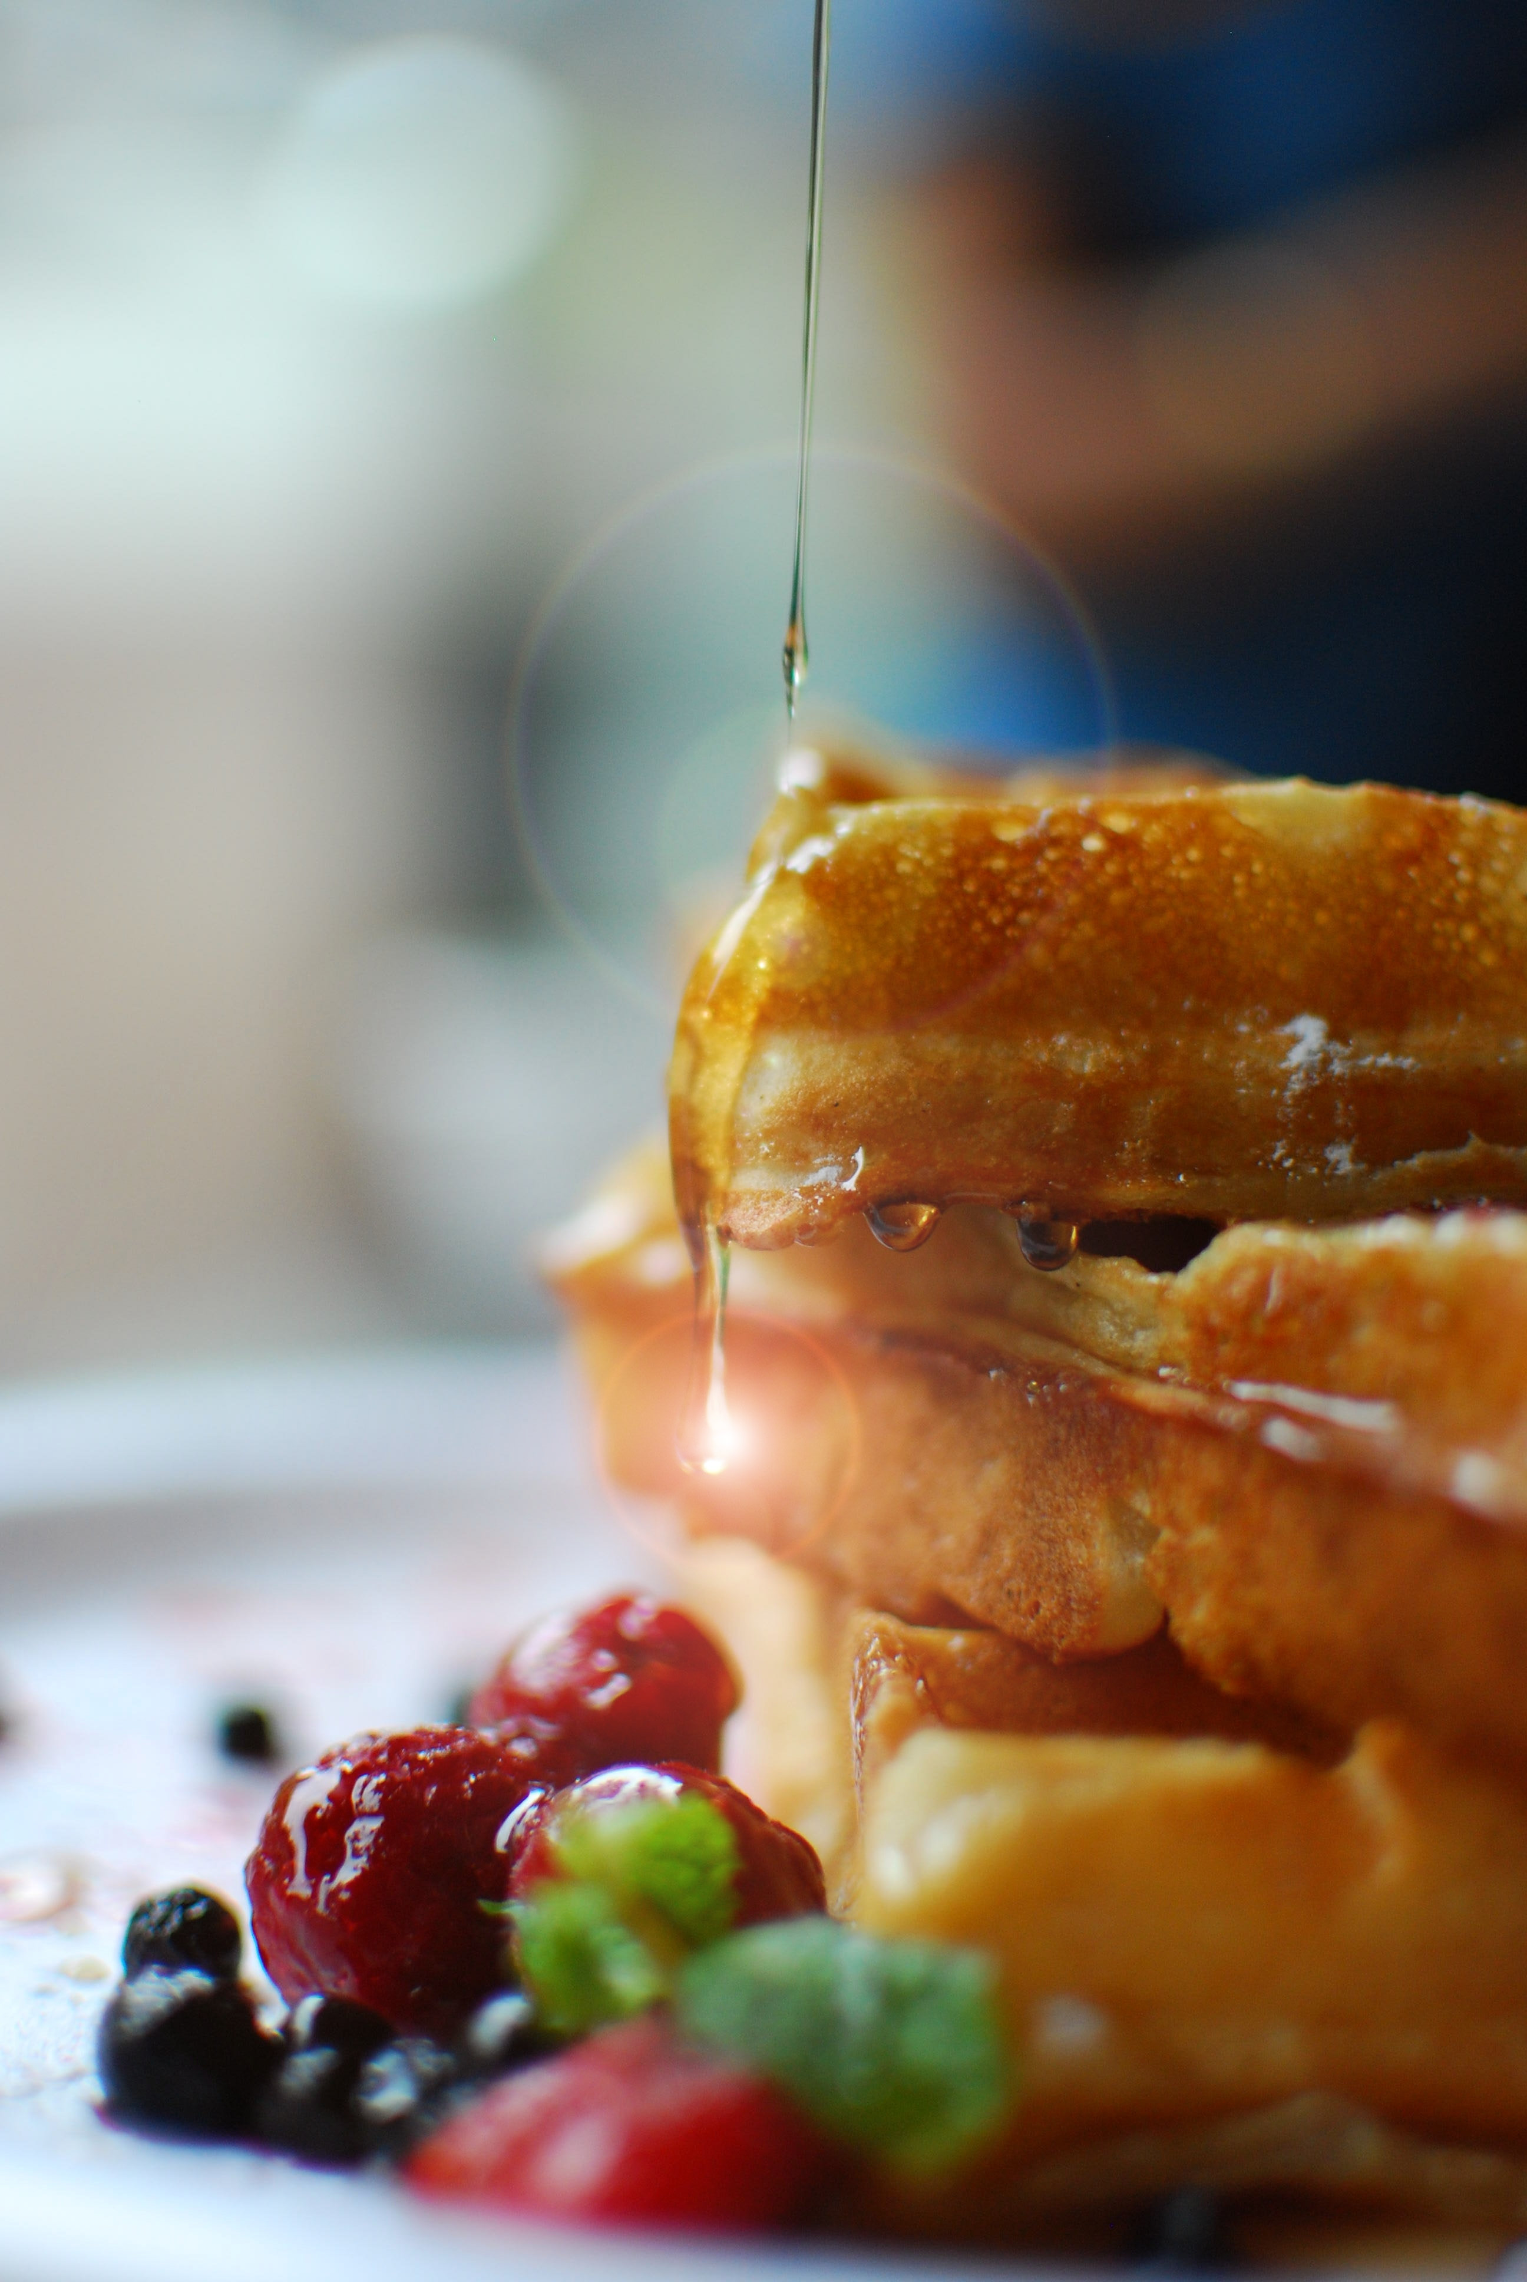
Masterclass Schedule
Day 4 31 august
Practical demo at Max IV:
X-Ray Absorption Spectroscopy
Kajsa Sigfridsson Claus
BALDER beamline
Day contact person: Tommy N. and Josefin M.

Slide 5
Masterclass Schedule
Day 5 Friday September1
Student pitches
9:00-10:00 Björn Bergenståhl, Lund University, to sum up...
10:00- 10:30 Break
10:30- 12:00 pitch presentation
Student presentations of own proposal
12:00-13:00 Lunch and goodbye
Day contact person: Milena C & Tommy N.

